Slide 1
AutoCAD drawing file to website prototype
By Elizabeth Gee
IconToo.com (prototype was formerly on dev-Sumerra.com) is a proof of concept site which was designed for demo purposes only.
Once it was approved, further development was done on the Sumerra development server.
This slide deck steps through the demo to show the client the features that they wanted.
AutoCAD drawing files on an iPad, for field use by building inspectors
Inspectors can select
A location on the map and zoom in.
the client, location, building, floor, etc.
Pinch zoom and pan on the AutoCAD drawing
Click on rooms on the drawing and display meta data about that room which is served up from a SQL Server database.
Database shall contain relationship of Clients to Properties
Property location, buildings, floors, rooms
Properties have different themes and branding
Please step through this demo in the steps shown in this slide deck

Slide 2
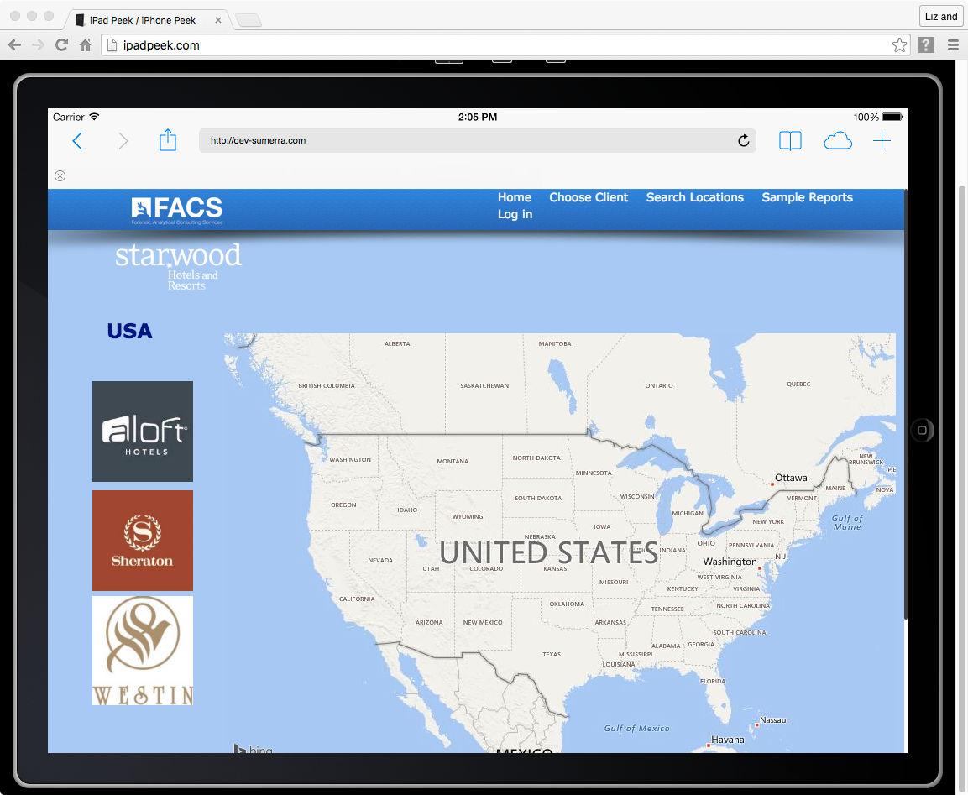
On a desktop, or iPad, or on iPadPeek.com, go to dev-sumerra.com
Click on Choose Client

Slide 3
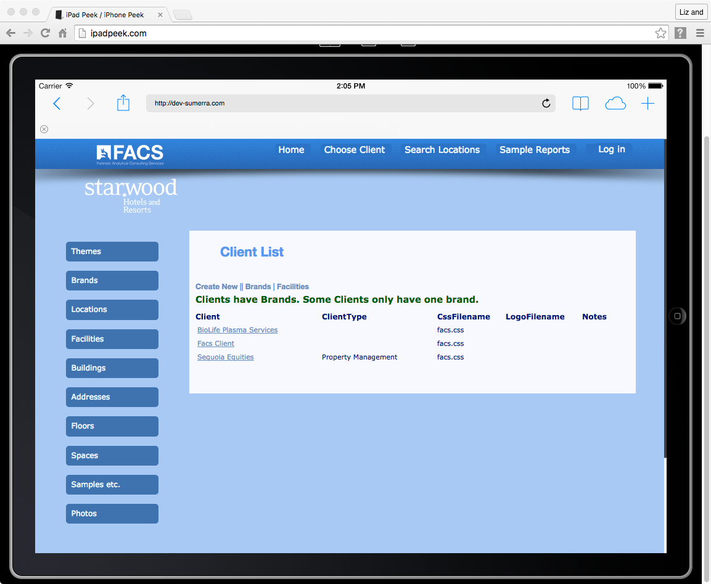
Click on Themes

Slide 4
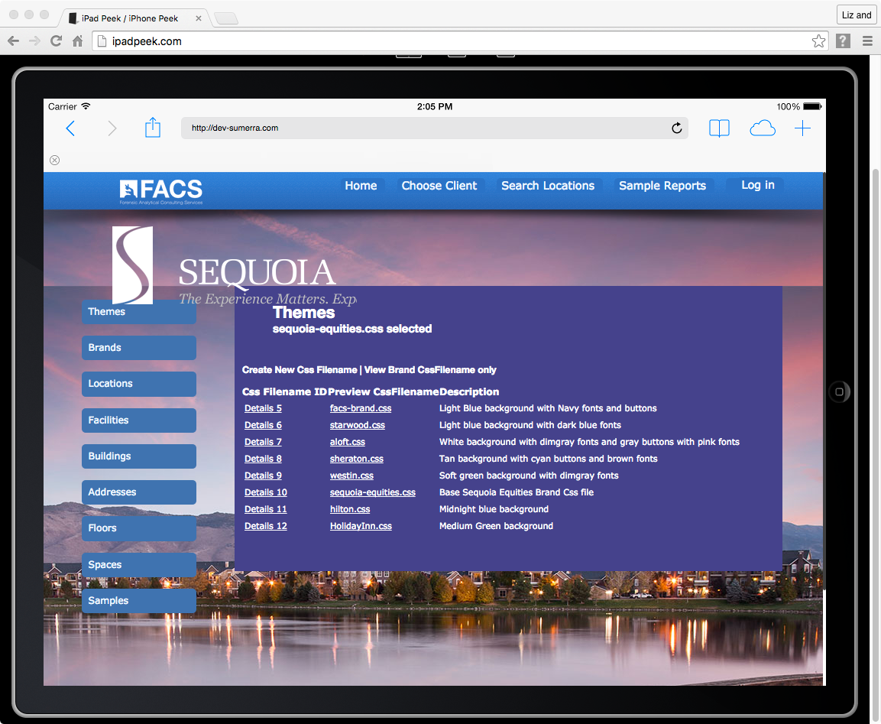
Click on Themes

Slide 5
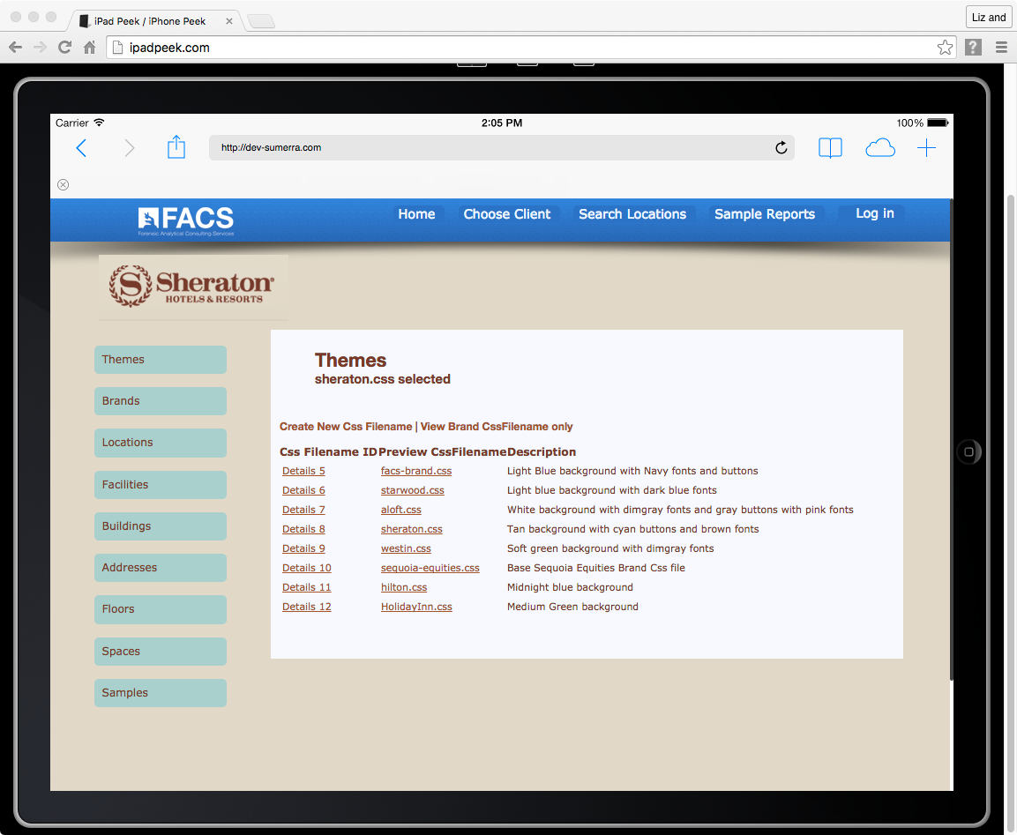
Click on Home

Slide 6
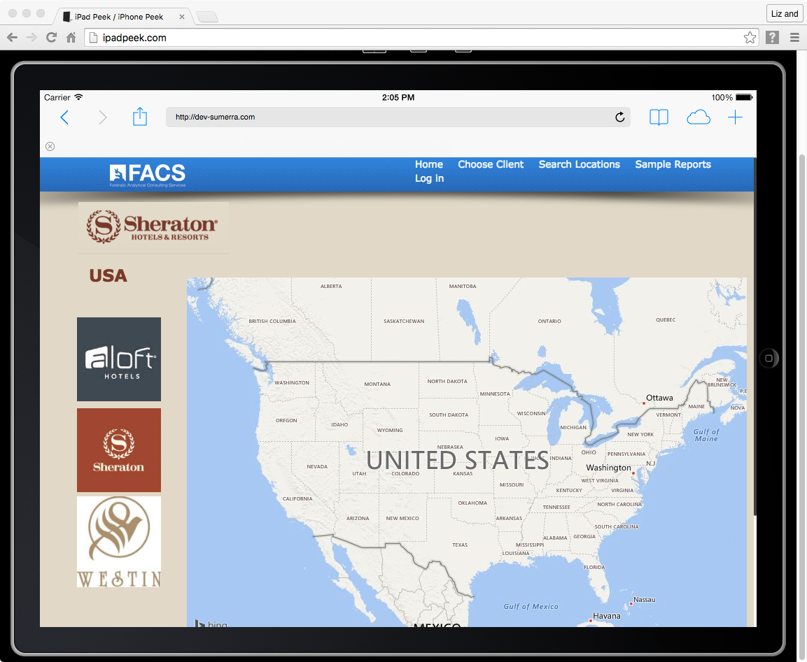
This uses Bing Maps API
Click on Illinois on map to zoom in.

Slide 7
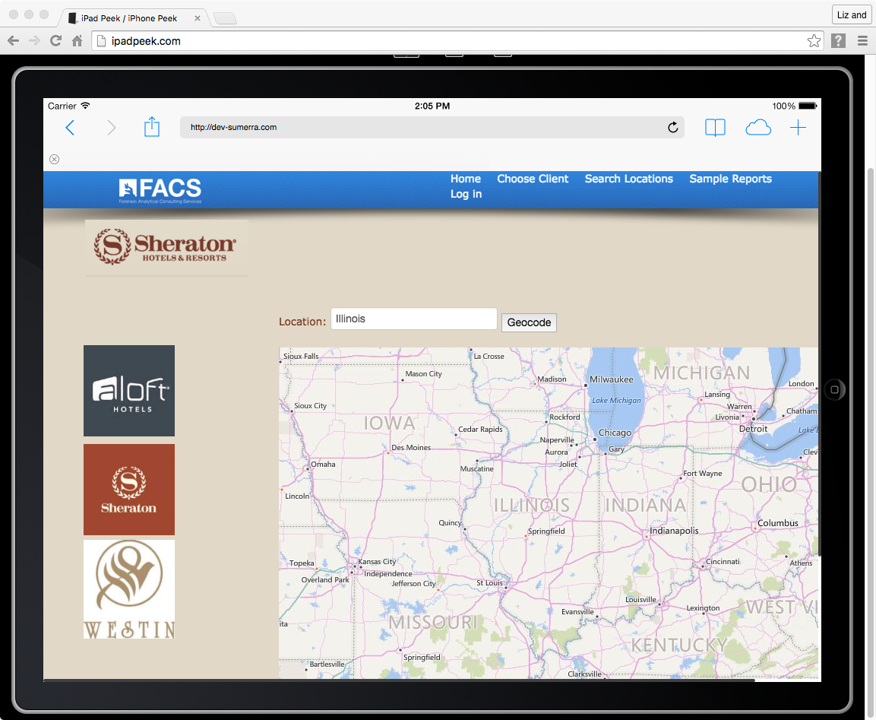

Slide 8
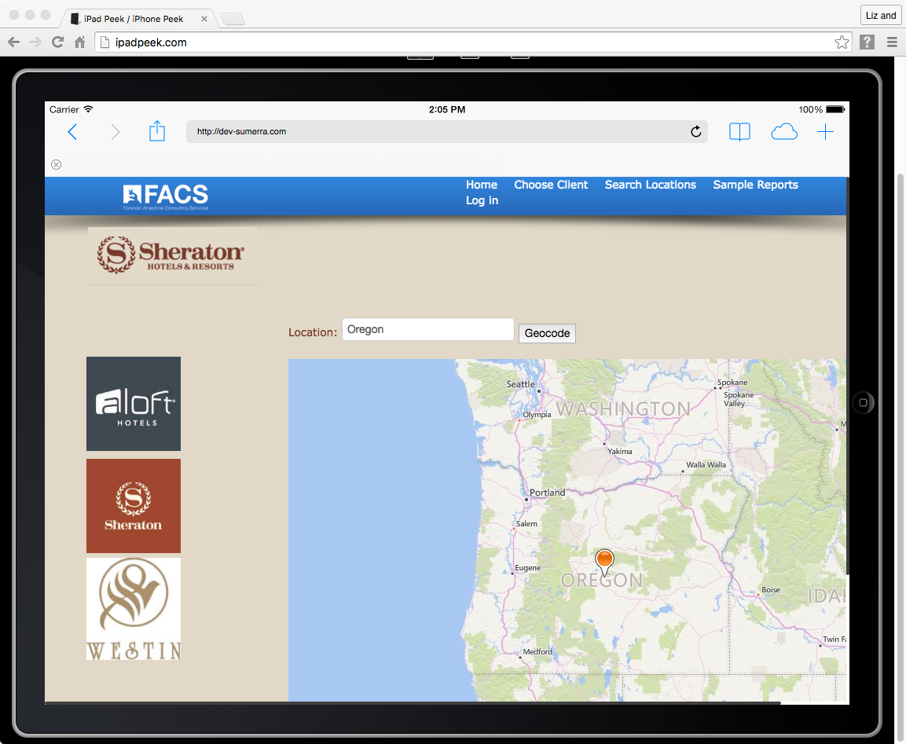
Type in Oregon and Click Geocode button
Click Sheraton
In this demo, this locates
A property location

Slide 9
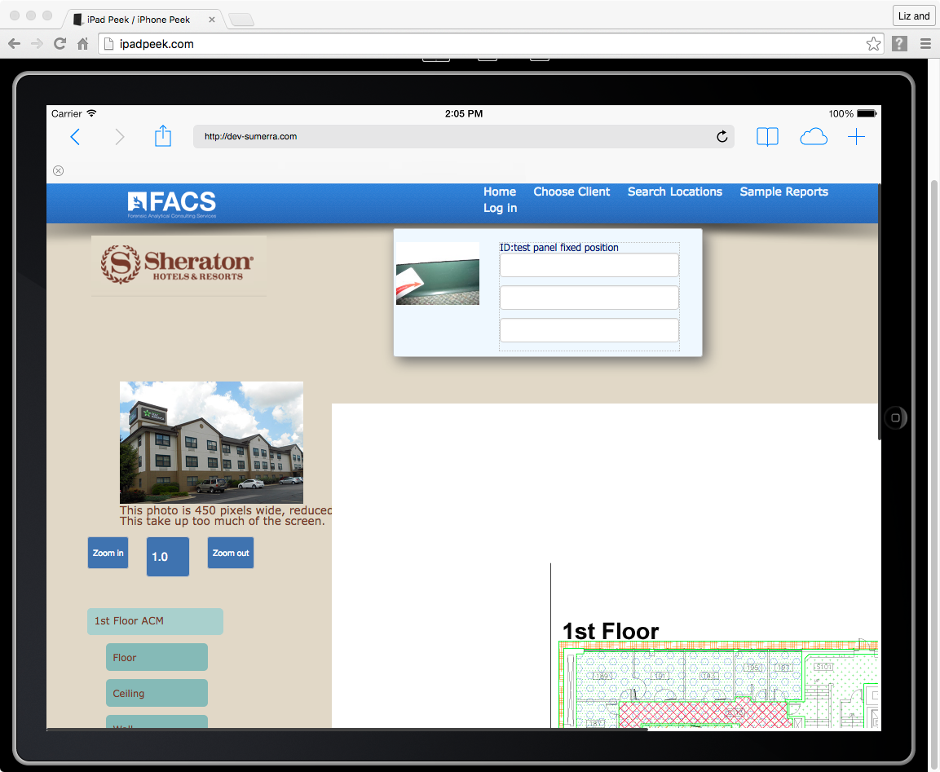
Click and drag this AutoCAD drawing.
This upper white space is the bounds of the actual AutoCAD drawing file.
If you are on an iPad, pinch to zoom.
If you are on a desktop, use the blue zoom buttons

Slide 10
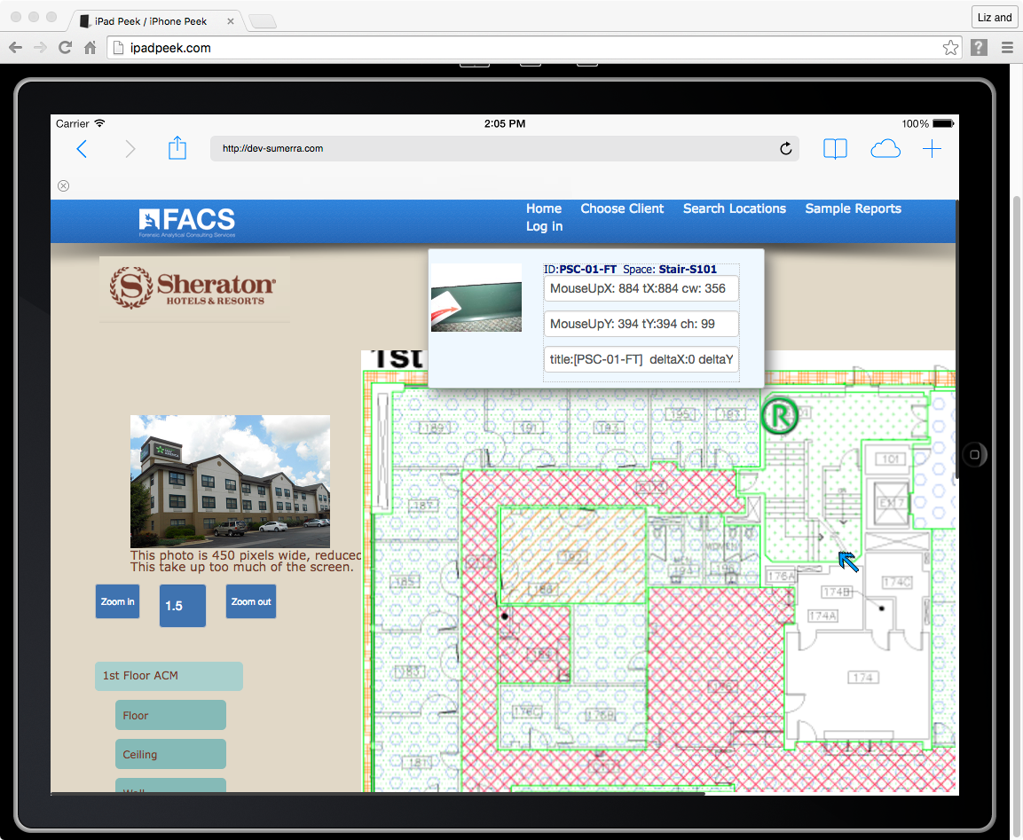
Notice the photo taken by the inspector and
The ID and Space name and title being served up from the SQL Server database
Click on the stairwell and notice the 2 indicators that this room was selected.
Many of the rooms are selectable but not all, since this is a demo/proof of concept
Notice Zoom factor

Slide 11
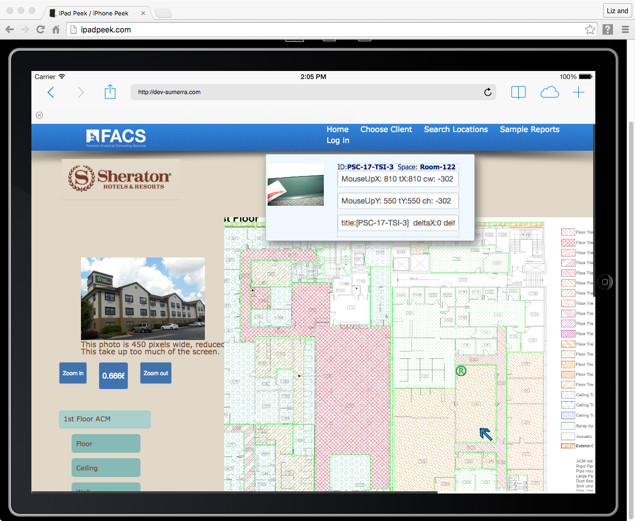
Click on Search Locations
Notice Zoom factor

Slide 12
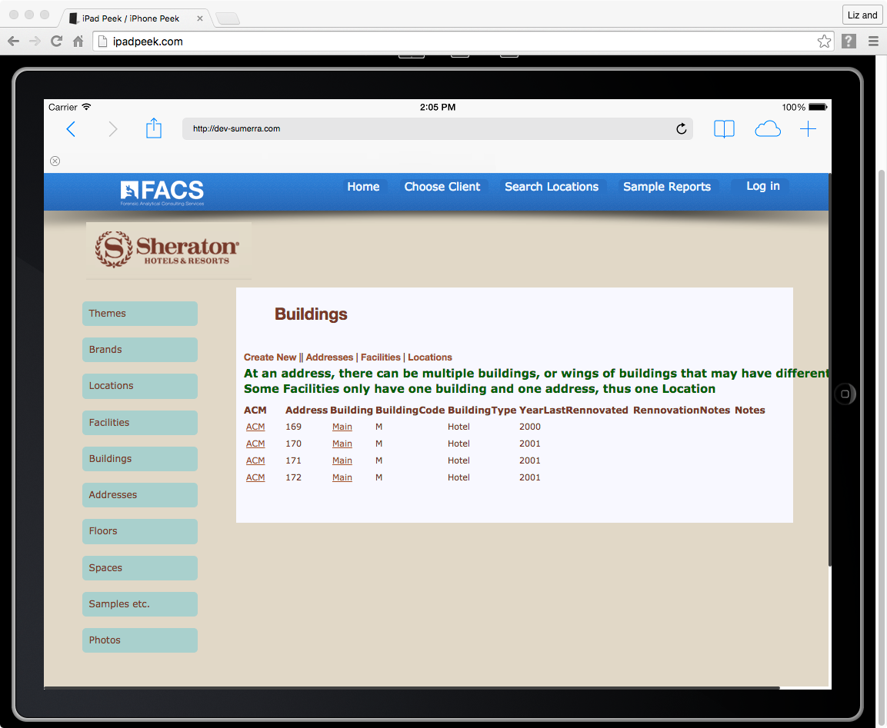
Alternative ways to get to the AutoCAD drawing
Click on ACM
Click on Menu Items top down
Click on Building to go to the next part of this demo.

Slide 13
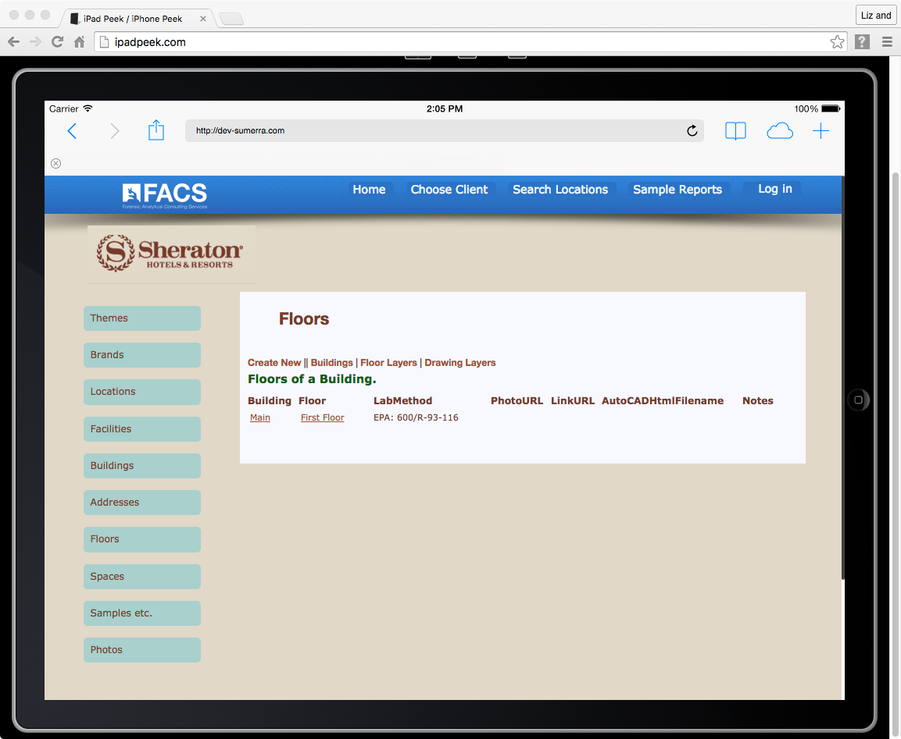
Click on First Floor

Slide 14
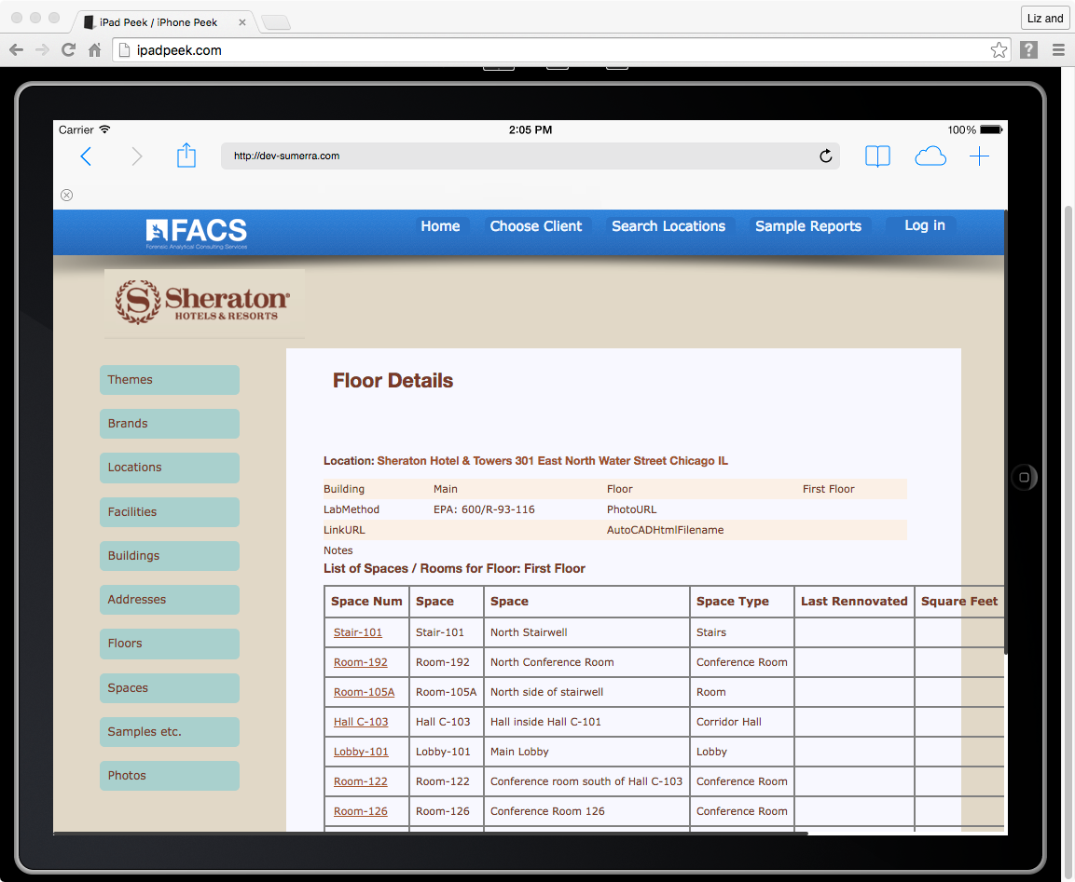
Click on Choose Sample Reports
List of spaces on this floor

Slide 15
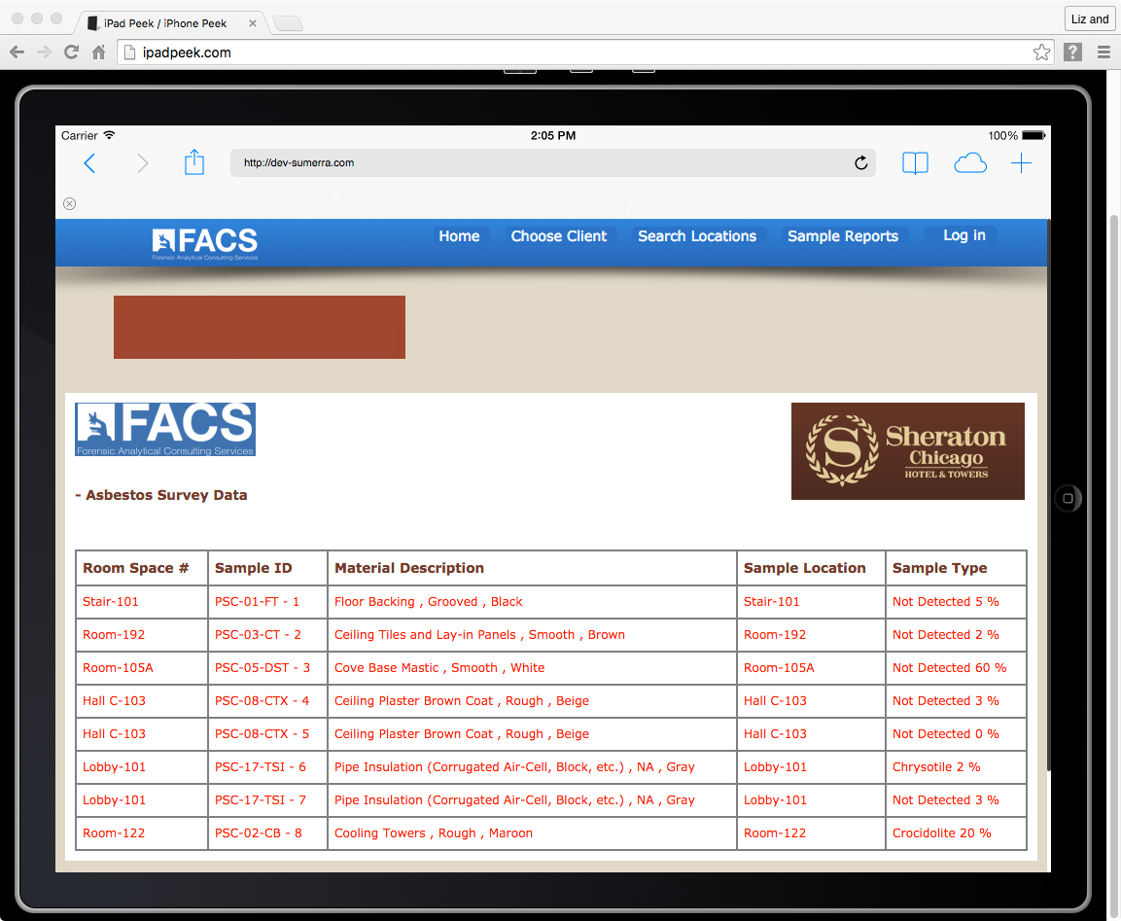

Slide 16
Closing
This demo is developed using SQL Server 2012 and MVC.Net 4.5
Implements Bing Maps API with Geocodes
Only two AutoCAD files and one image exist in this demo, since it is a demo
Any inconsistencies or presumed errors are not a consideration, due to the time allotted to develop this demo
Post approval, the rest of the project was completed on the Summera dev servers.

